Slide 1
Argumentation and Answer Set Programming
Francesca Toni and Marek Sergot
2011

Slide 2

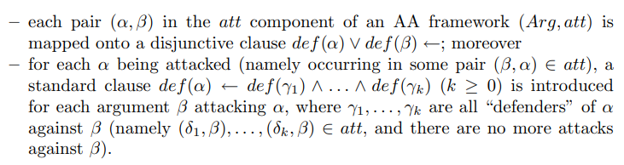
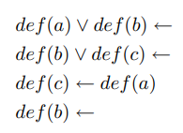
Nieves 2008
产生了一个定义谓词def的析取逻辑程序，其中def(α)可以读作自变量α被击败。
Preferred
1{d(a); d(b)}1 :- .
1{d(c); d(b)}1 :- .
d(c) :- d(a).
d(b) :- .

Slide 3

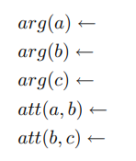
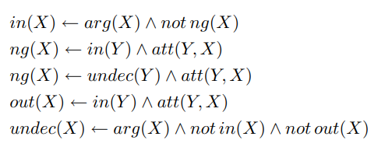
Wakaki and Nitta 2009
complete
in(X) :- arg(X), not ng(X).
ng(X) :- in(Y), att(Y, X).
ng(X) :- undec(Y), att(Y, X).
out(X) :- in(Y), att(Y, X).
undec(X) :- arg(X), not in(X), not out(X).

Slide 4



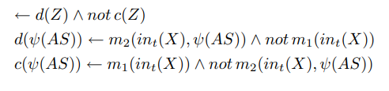
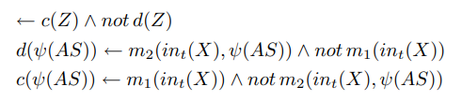
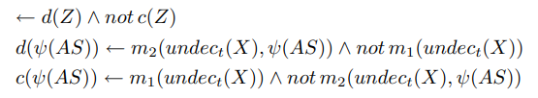
stable
common core
Preferred
Grounded
Semi-stable

Slide 5
Complete:
arg(a).
arg(b).
arg(c).
att(a, b).
att(b, c).
in(X) :- arg(X), not ng(X).
ng(X) :- in(Y), att(Y, X).
ng(X) :- undec(Y), att(Y, X).
out(X) :- in(Y), att(Y, X).
undec(X) :- arg(X), not in(X), not out(X).

Slide 6
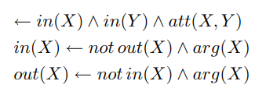



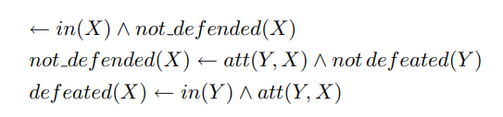
Egly, Gaggl and Woltran 2008
conflict-free
:- in(X), in(Y), att(X, Y).
in(X) :- not out(X), arg(X).
out(X) :- not in(X), arg(X).
:- out(X), not defeated(X).
defeated(X) :- in(Y), att(Y, X).
:- in(X), not_defended(X).
not_defended(X) :- att(Y, X), not defeated(Y).
defeated(X) :- in(Y), att(Y, X).
stable
admissible

Slide 7


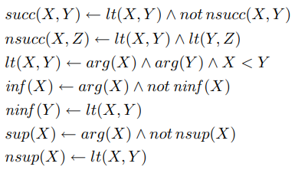
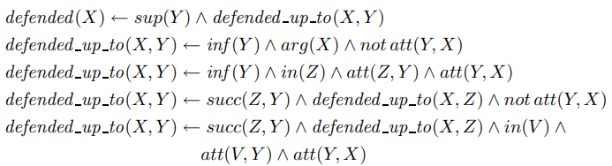

complete
:- out(X), not not_defended(X).
succ(X, Y) :- lt(X, Y), not nsucc(X, Y).
nsucc(X, Z) :- lt(X, Y), lt(Y, Z).
lt(X, Y) :- arg(X), arg(Y), X < Y.
inf(X) :- arg(X), not ninf(X).
ninf(Y) :- lt(X, Y).
sup(X) :- arg(X), not nsup(X).
nsup(X) :- lt(X, Y).
defended(X) :- sup(Y), defended_up_to(X, Y).
defended_up_to(X, Y) :- inf(Y), arg(X), not att(Y, X).
defended_up_to(X, Y) :- inf(Y), in(Z), att(Z, Y), att(Y, X).
defended_up_to(X, Y) :- succ(Z, Y), defended_up_to(X, Z), not att(Y, X).
defended_up_to(X, Y) :- succ(Z, Y), defended_up_to(X, Z), in(V), att(V, Y), att(Y, X).
in(X) :- defended(X).
grounded
define infimum inf , supremum sup and successor succ
all arguments defended (by all arguments currently in)
all defended arguments should be in

Slide 8

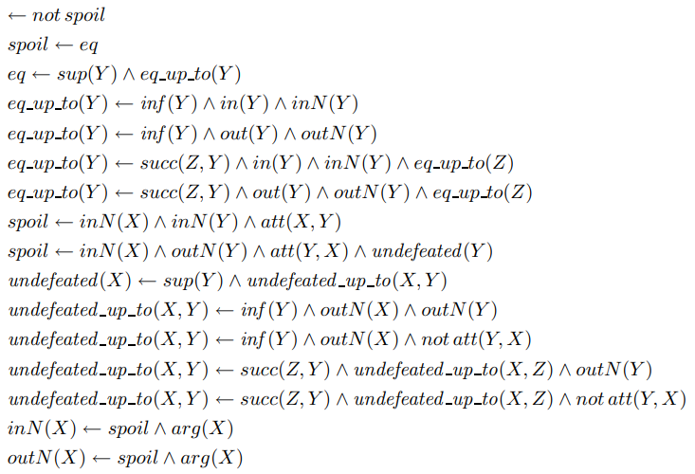
:- not spoil.
spoil :- eq.
eq :- sup(Y), eq_up_to(Y).
eq_up_to(Y) :- inf(Y), in(Y), inN(Y).
eq_up_to(Y) :- inf(Y), out(Y), outN(Y).
eq_up_to(Y) :- succ(Z, Y), in(Y), inN(Y), eq_up_to(Z).
eq_up_to(Y) :- succ(Z, Y), out(Y), outN(Y), eq_up_to(Z).
spoil :- inN(X), inN(Y), att(X, Y).
spoil :- inN(X), outN(Y), att(Y, X), undefeated(Y).
undefeated(X) :- sup(Y), undefeated_up_to(X, Y).
undefeated_up_to(X, Y) :- inf(Y), outN(X), outN(Y).
undefeated_up_to(X, Y) :- inf(Y), outN(X), not att(Y, X).
undefeated_up_to(X, Y) :- succ(Z, Y), undefeated_up_to(X, Z), outN(Y).
undefeated_up_to(X, Y) :- succ(Z, Y), undefeated_up_to(X, Z), not att(Y, X).
inN(X) :- spoil, arg(X).
outN(X) :- spoil, arg(X).
preferred

Slide 9
Grouded:
arg(a).
arg(b).
arg(c).
att(a, b).
att(b, c).
:- in(X), in(Y), att(X, Y).
in(X) :- not out(X), arg(X).
out(X) :- not in(X), arg(X).
:- in(X), not_defended(X).
not_defended(X) :- att(Y, X), not defeated(Y).
defeated(X) :- in(Y), att(Y, X).
:- out(X), not not_defended(X).
succ(X, Y) :- lt(X, Y), not nsucc(X, Y).
nsucc(X, Z) :- lt(X, Y), lt(Y, Z).
lt(X, Y) :- arg(X), arg(Y), X < Y.
inf(X) :- arg(X), not ninf(X).
ninf(Y) :- lt(X, Y).
sup(X) :- arg(X), not nsup(X).
nsup(X) :- lt(X, Y).
defended(X) :- sup(Y), defended_up_to(X, Y).
defended_up_to(X, Y) :- inf(Y), arg(X), not att(Y, X).
defended_up_to(X, Y) :- inf(Y), in(Z), att(Z, Y), att(Y, X).
defended_up_to(X, Y) :- succ(Z, Y), defended_up_to(X, Z), not att(Y, X).
defended_up_to(X, Y) :- succ(Z, Y), defended_up_to(X, Z), in(V), att(V, Y), att(Y, X).
in(X) :- defended(X).
arg(a)
arg(b)
arg(c)
att(a,b)
att(b,c)
defended(a)
defended(c)
defended_up_to(a,a)
defended_up_to(a,b)
defended_up_to(a,c)
defended_up_to(c,a)
defended_up_to(c,b)
defended_up_to(c,c)
defeated(b)
in(a)
in(c)
inf(a)
lt(a,b)
lt(a,c)
lt(b,c)
ninf(b)
ninf(c)
not_defended(b)
nsucc(a,c)
nsup(a)
nsup(b)
out(b)
succ(a,b)
succ(b,c)
sup(c)
not_defended(b): b 没有被防卫
defeated(b): b 被击败
lt(a,b): a 小于 b
nsucc(a,c): a 不是 c 的直接前驱
ninf(b): b 不是最小元
inf(a): a 是最小元
nsup(a): a 不是最大元
sup(c): c 是最大元
defended_up_to(a,a): a 被 a 自身防卫

Slide 10
逻辑思维题目（溯因推理）
阿德里安、布福德和卡特三人去餐馆吃饭，他们每人要的不是火腿就是猪排。
（1） 如果阿德里安要的是火腿，那么布福德要的就是猪排。
（2） 阿德里安或卡特要的是火腿，但是不会两人都要火腿。
（3） 布福德和卡特不会两人都要猪排。
谁昨天要的是火腿，今天要的是猪排？

Slide 11
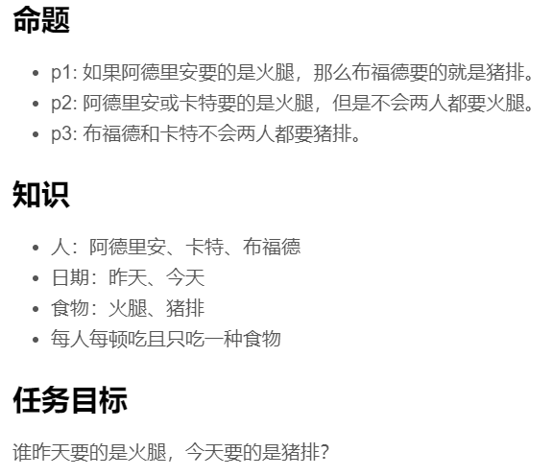
person(a).
person(b).
person(c).
food(ham).
food(pork).
day(yes).
day(tod).
1{eat(P, F, D):food(F)}1 :- person(P), day(D).

Slide 12
2:
p(1, D) :- eat(a, ham, D), eat(b, pork, D), day(D).
p(1, D) :- not eat(a, ham, D), eat(b, F, D), day(D).
-p(1):- not p(1, D), day(D).
p(2, D) :- eat(a, ham, D), not eat(c, ham, D), day(D).
p(2, D) :- not eat(a, ham, D), eat(c, ham, D), day(D).
-p(2):- not p(2, D), day(D).
p(3, D) :- not eat(b, pork, D), day(D).
p(3, D) :- not eat(c, pork, D), day(D).
-p(3):- not p(3, D), day(D).
1:
-p(1) :- eat(a, ham, D), not eat(b, pork, D), day(D).
-p(2) :- not eat(a, ham, D), not eat(c, ham, D), day(D).
-p(2) :- eat(a, ham, D), eat(c, ham, D), day(D).
-p(3) :- eat(b, pork, D), eat(c, pork, D), day(D).

Slide 13
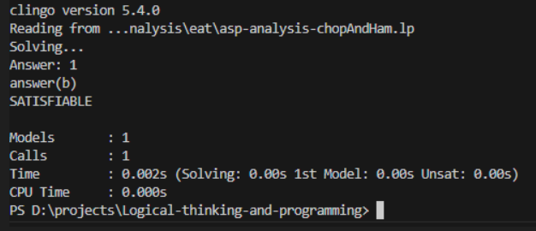
3{p(1;2;3)}3.
answer(P) :- person(P), eat(P, ham, yes), eat(P, pork, tod).
:- 0{answer(P):person(P)}0.
% #show eat/3.
% #show p/1.
#show answer/1.

